Slide 1


Slide 2
U.S. Semiquincentennial Commission
Congress established the U.S. Semiquincentennial Commission to lead the nationwide commemoration. Honorary President General Lynn Forney Young is a charter member.
Federal, state and private partnerships are being created.
The dates being honored:
  From the Boston Tea Party of 1773 (e.g.2023)
  Through the Treaty of Paris in 1783 (e.g.2033)

Slide 3
America 250! Committee
Seeks to highlight and educate to your Chapter and Community the role of your Patriots in the Revolution.
Focuses your Chapter’s existing community impact to Patriot’s activities.
We want you to share about your Patriots.
Your ancestors that helped make this country!

Slide 4
Chapter Activities & CMR Answers Part 1 of 2
Name an America 250! Chair within your Chapter
  Patriot Minute is CMR#1 & 2 & 6
  “Revolutionary Flashbacks” is CMR#2
Create your Patriot Snapshot & Patriot Story
  Snapshot is CMR#3a & 4 & 6
  Patriot Story submissions are CMR#3 & 4 & 6
Rediscover, Restore and Rededicate Revolutionary War related monuments, plaques, gravesites and other memorials in your community

Slide 5
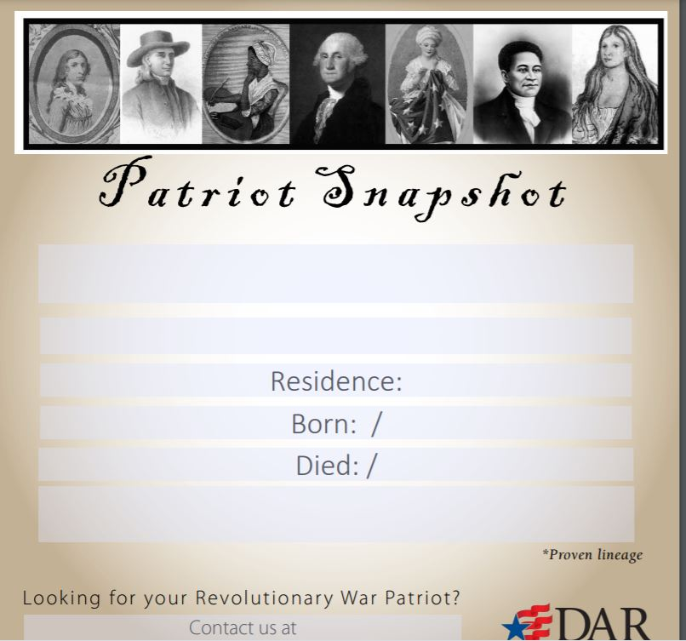

Slide 6
The Patriot Snapshot Template
The people are (from left to right): Deborah Sampson, Stephen Hopkins, Phillis Wheatley, George Washington, Betsy Ross, Crispus Attucks, and Nancy Ward.
Deborah Sampson is highlighted in the November 2020 Patriot Post (page 24). Deborah disguised herself as a man and joined the Continental Army. She is a verified Patriot for the DAR and SAR.
Stephen Hopkins is a signer of the Declaration of Independence. He was a governor of the Colony of Rhode Island.
Phillis Wheatley is mentioned in the February 2021 Patriot Post (page 26). Phillis was a slave who was purchased to be a companion to Mrs. Wheatley. Phillis became a published poet.
George Washington, the first President of the United States after serving as the Commander in Chief of the Continental Army.
Betsy Ross (Elizabeth Griscom Ross) is known to have made flags during the American Revolution.
Crispus Attucks is highlighted in February 2021 Patriot Post and mentioned again in January 2020. He was one of the four Boston Massacre casualties.
Nancy Ward is highlighted in the April 2020 Patriot Post. She is a Cherokee who held the position of Beloved Woman.

Slide 7
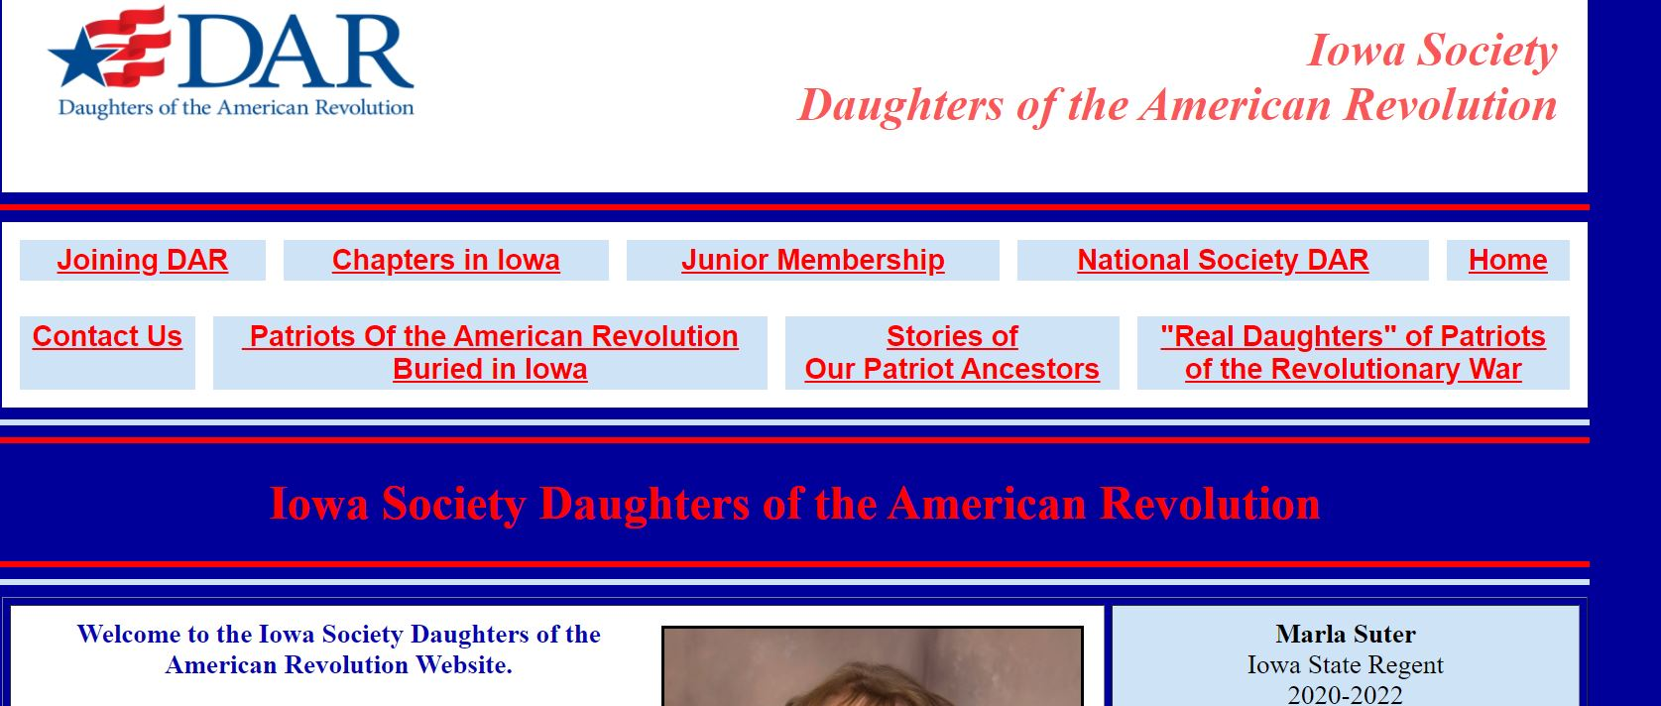
CMR #1, 2, 3, 4, 6 Patriot Story
ISDAR public website

Slide 8
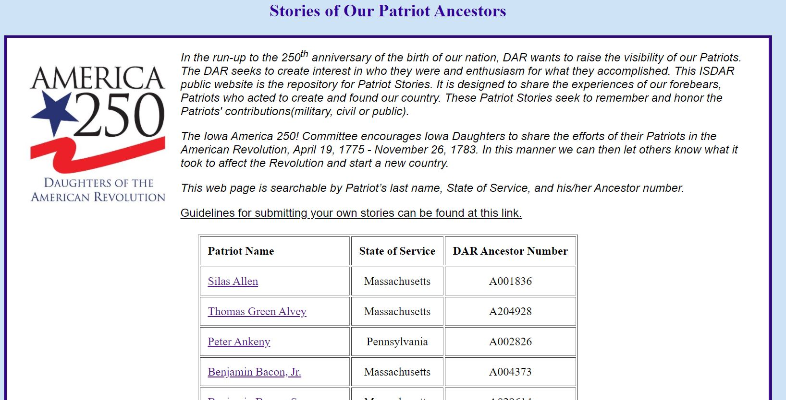
Guidelines are available for you.
Submit your stories to us!

Slide 9
Chapter Activities & CMR Answers Part 2 of 2
Our Patriot’s Coloring Book CMR 3c is a multi-generational activity book way to learn about various Patriots. This educational and fun book makes a great gift for many occasions & ages!
Plan and hold a Patriot Memorial Service CMR 2–coordinate with Chapter Chaplain
Initiate a Book Club CMR 2 and/or CMR3 -- coordinate with Librarian & Literacy Committee. The Book Club members may extend beyond Chapter Members.

Slide 10
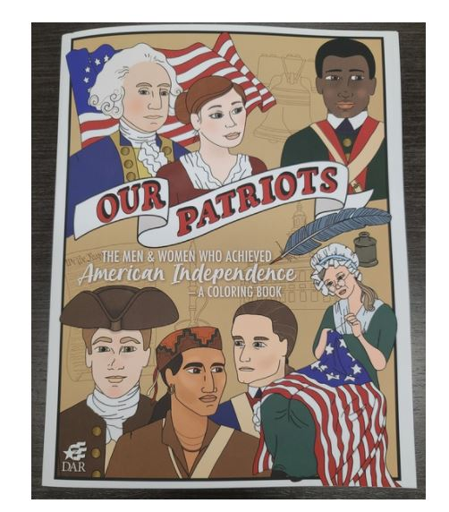
Our Patriots ($10.95) from DAR Store
CMR #3c

Slide 11
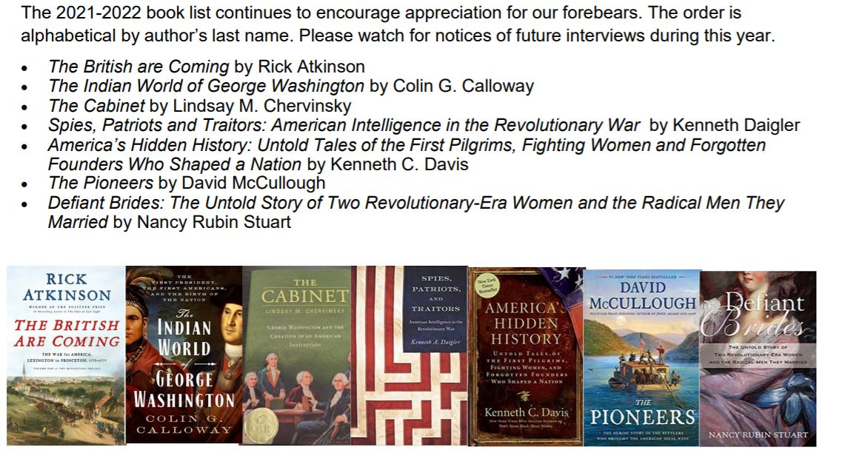
Book Club is CMR 2 and/or CMR3c

Slide 12
America 250! Challenge
We challenge each Chapter to write and submit 2 Patriot Stories by the end of the Van Buren Administration -- within the next 9 months!

