Slide 1
ISDAR School Bus Tour
September 18-25 2021

Slide 2
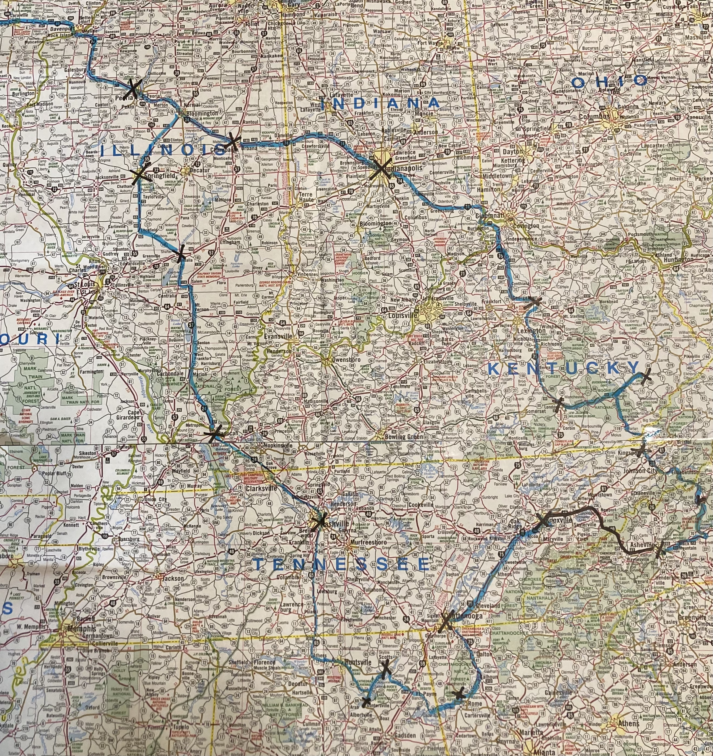
Iowa DAR Schools Bus Trip 2021
Nine Days
4 of 5 DAR Schools
States included IA,IL,IN,OH, KY, NC, TN, Al and GA
11 DAR Members
3 HODARS
1 Crazy Bus Driver (Tom)
Stops in Paris and London w/o passports

Slide 3
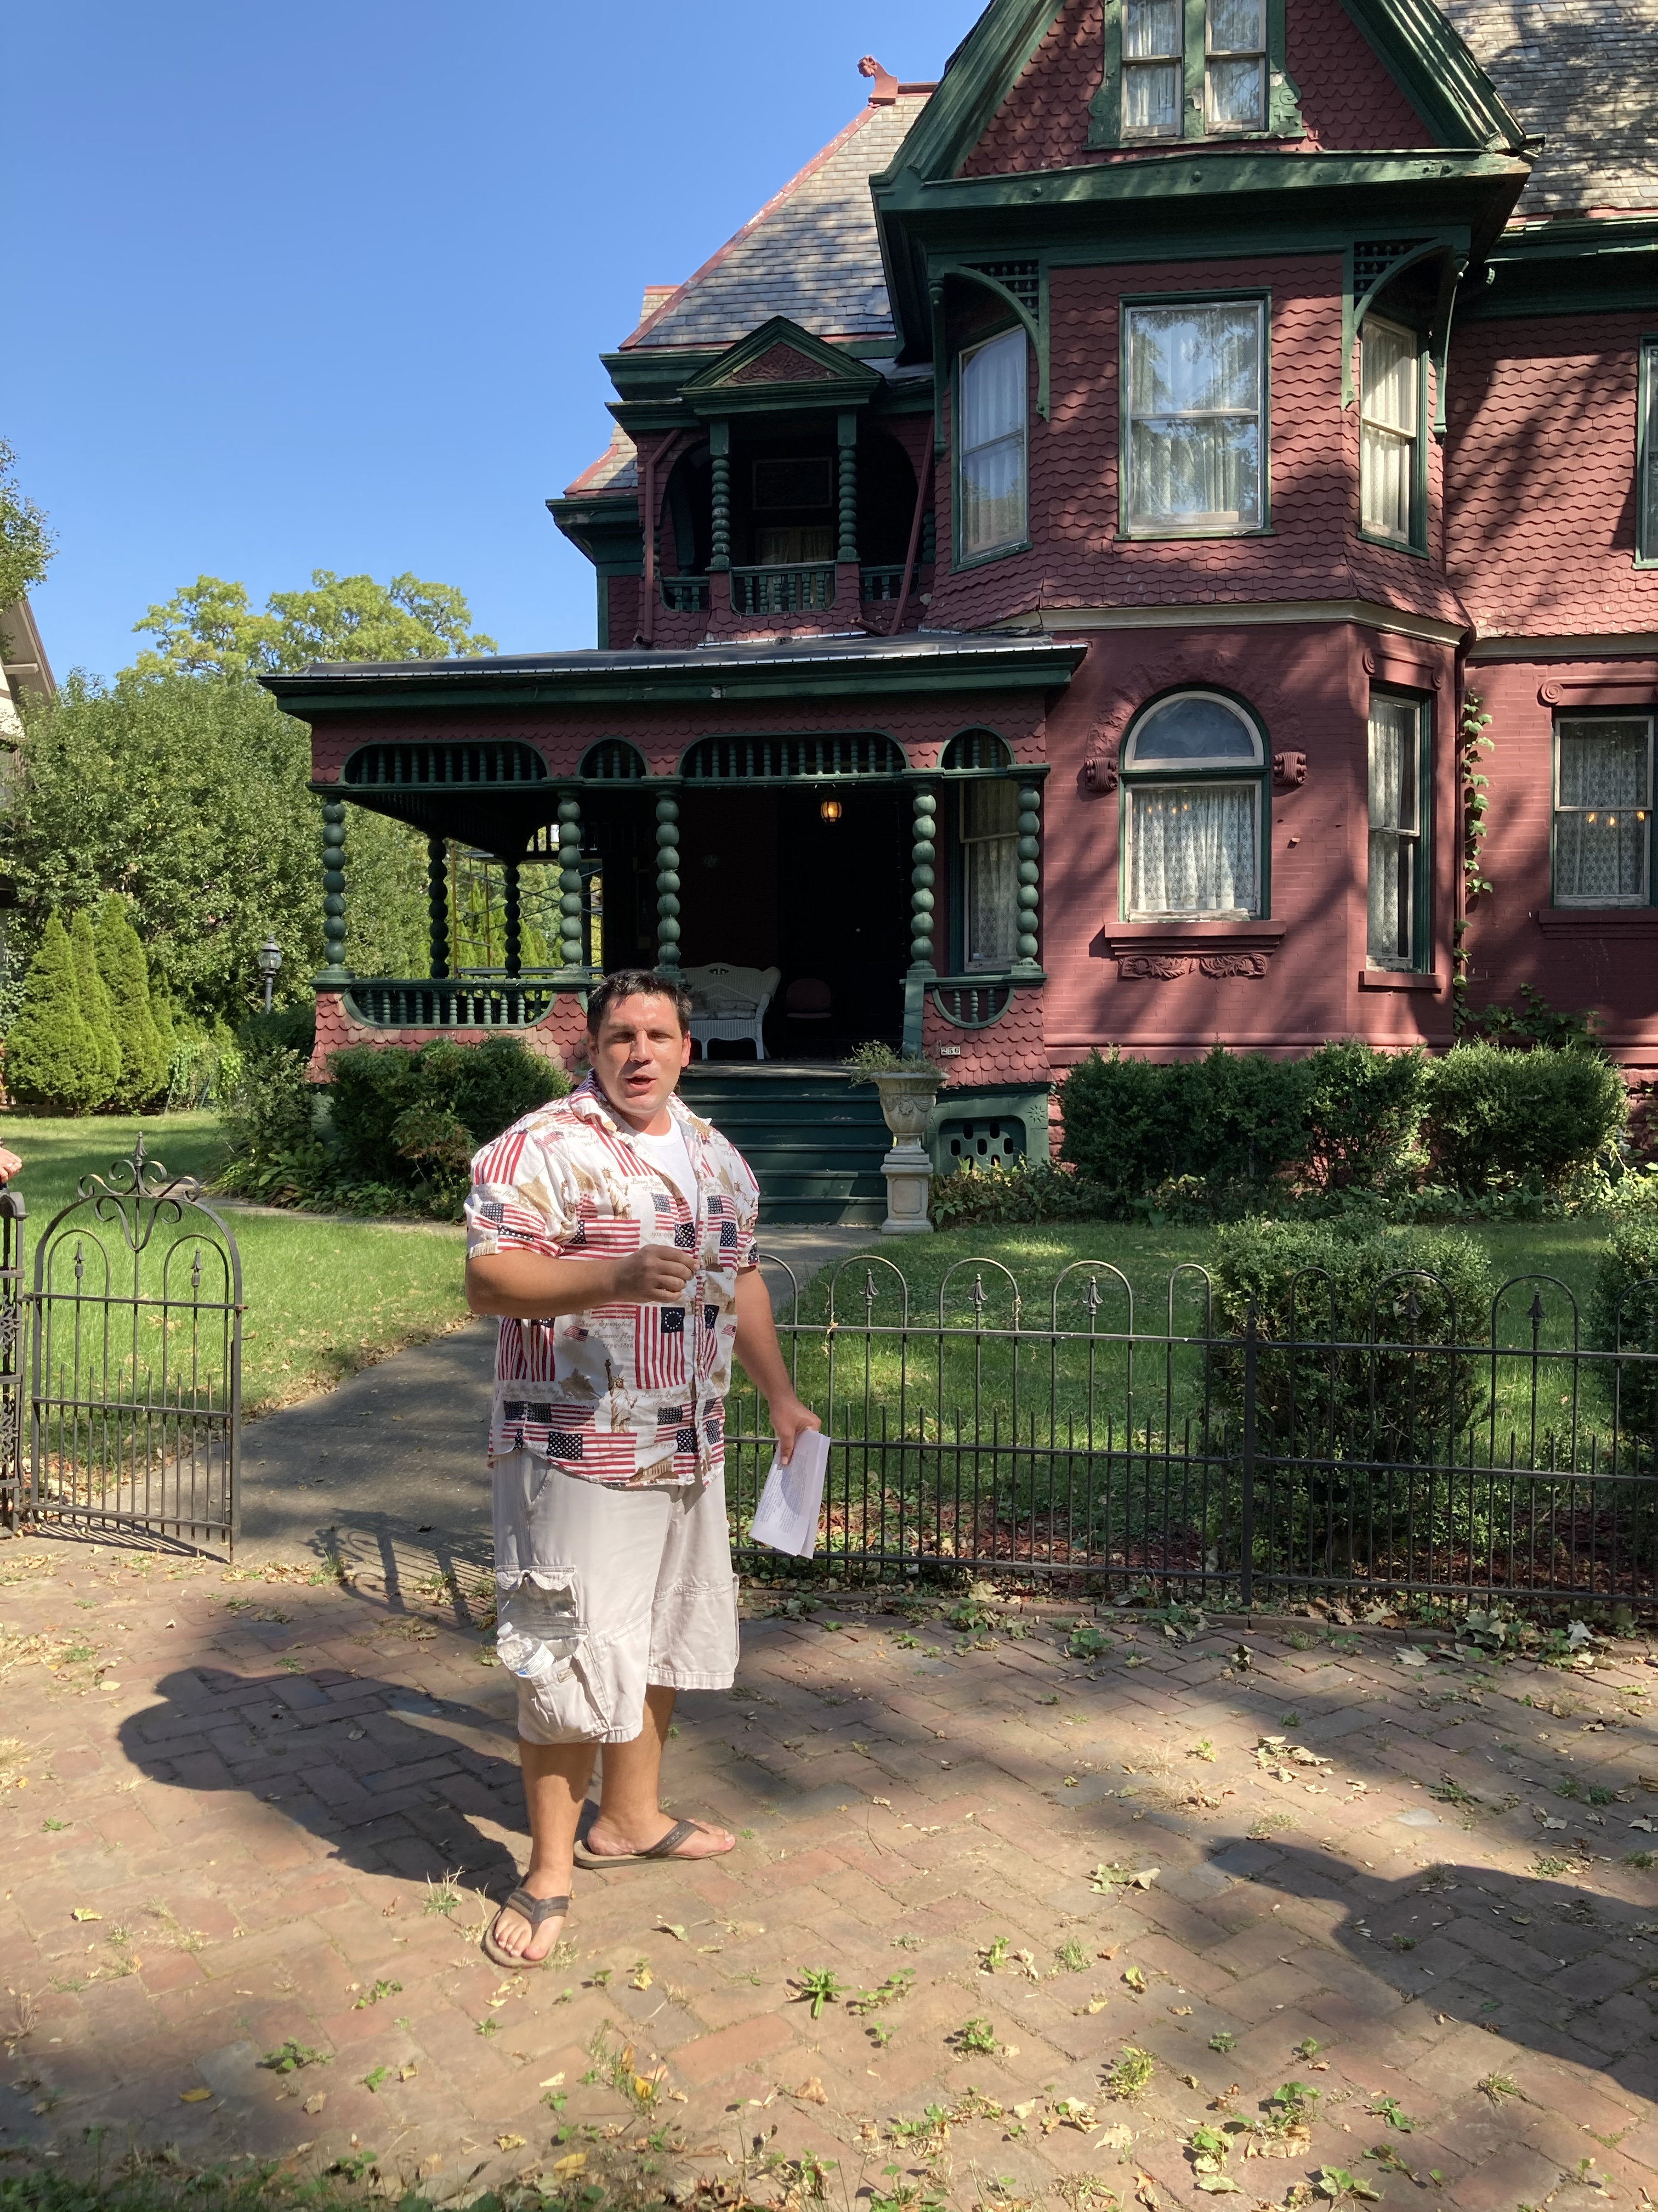
Historic District Tour Peoria, IL
September 18
Our Tour Guide
Notice his Patriotic shirt

Slide 4
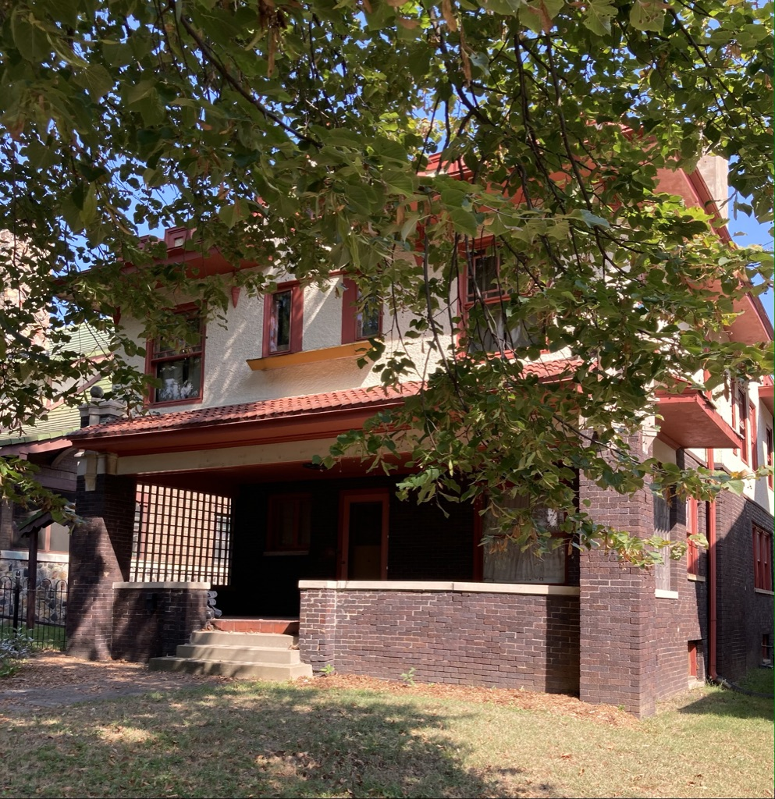
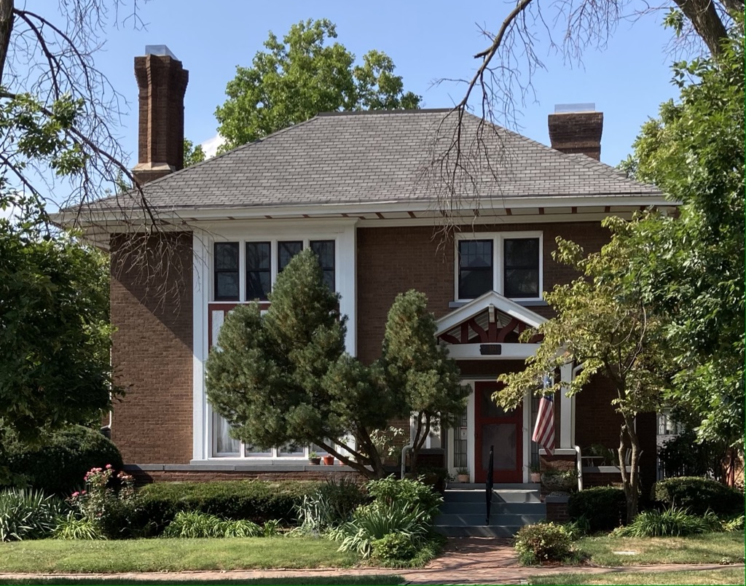
Private Victorian Homes
on the Historic Register

Slide 5
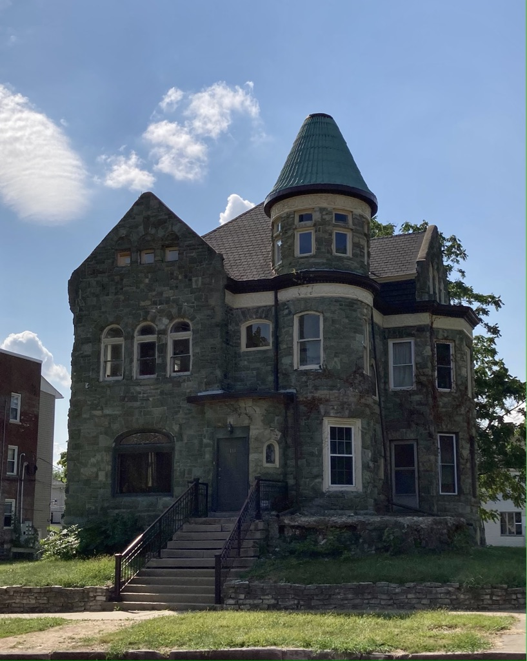
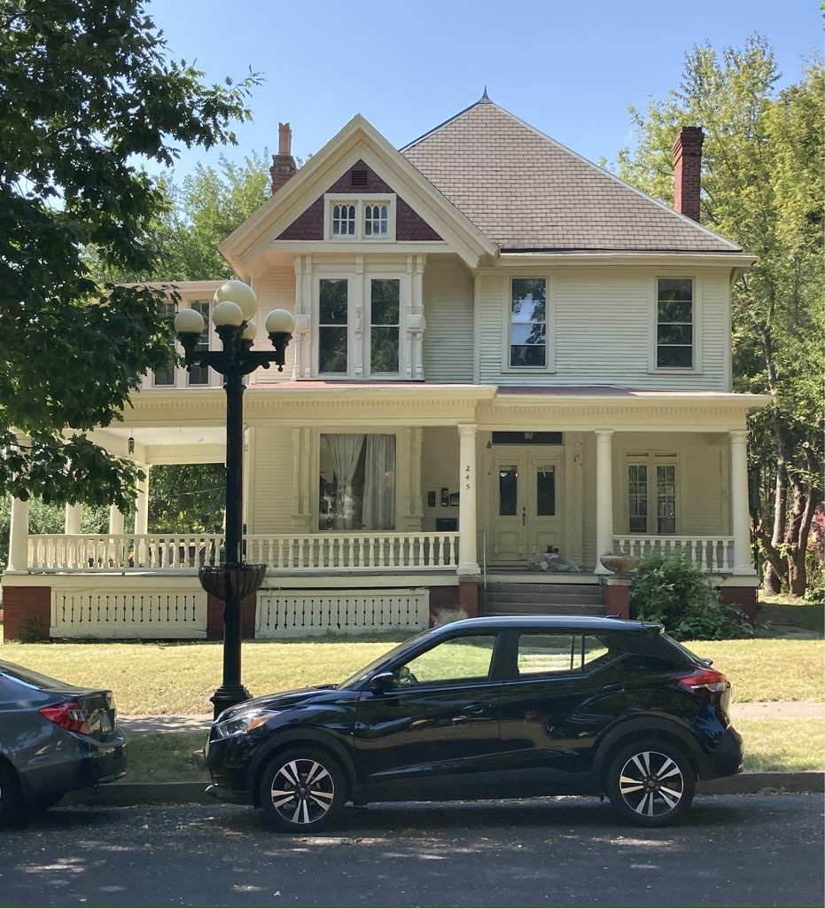
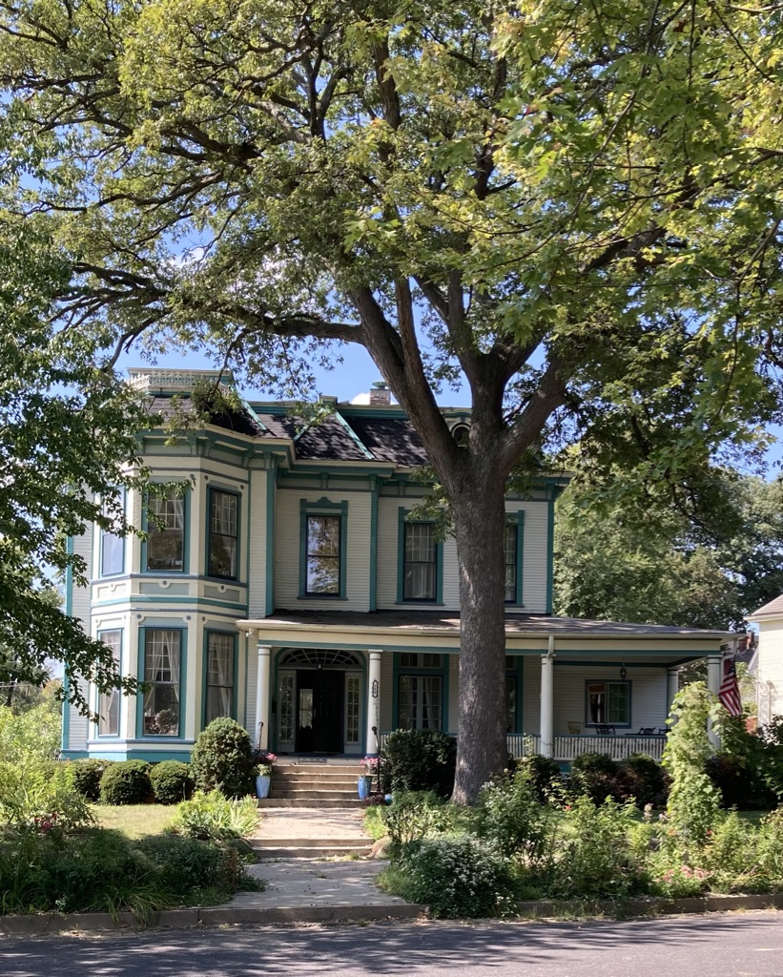

Slide 6
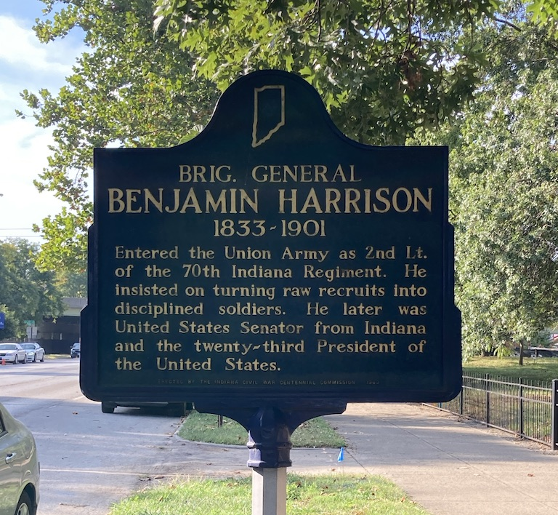
Benjamin Harrison Home, Indianapolis,IN
September 19 2020

Slide 7
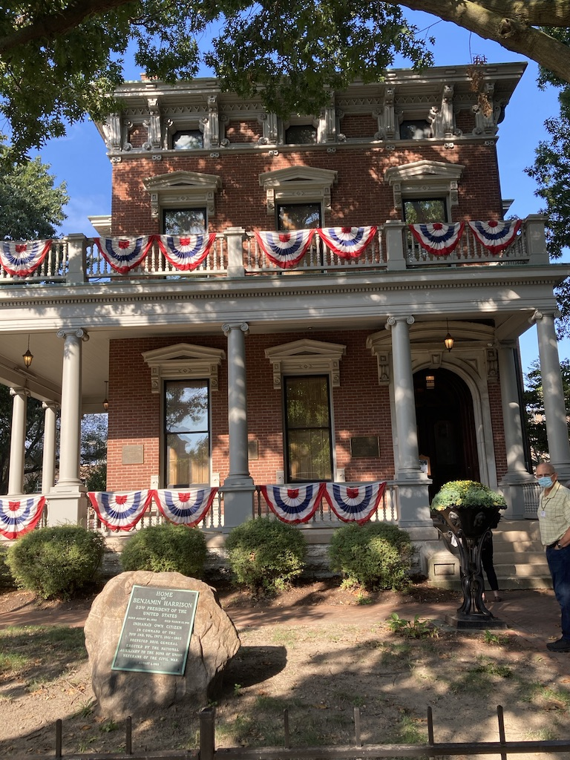
This 16-room Italianate style house, carriage house, brick drive and landscaping, cost $24,008.59 when it was built in 1874.

Slide 8
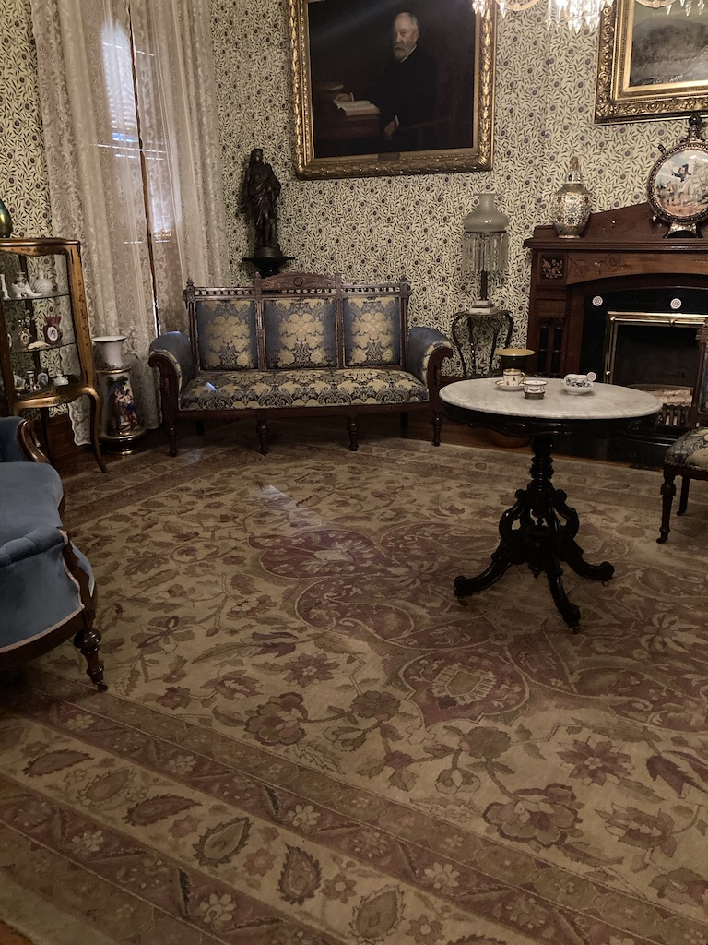
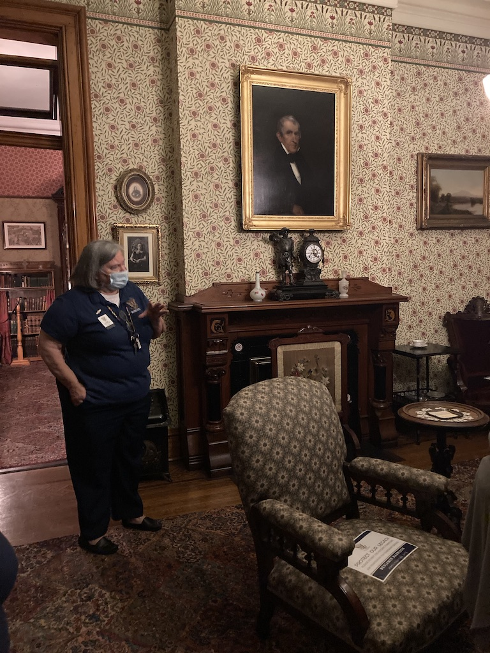

Slide 9
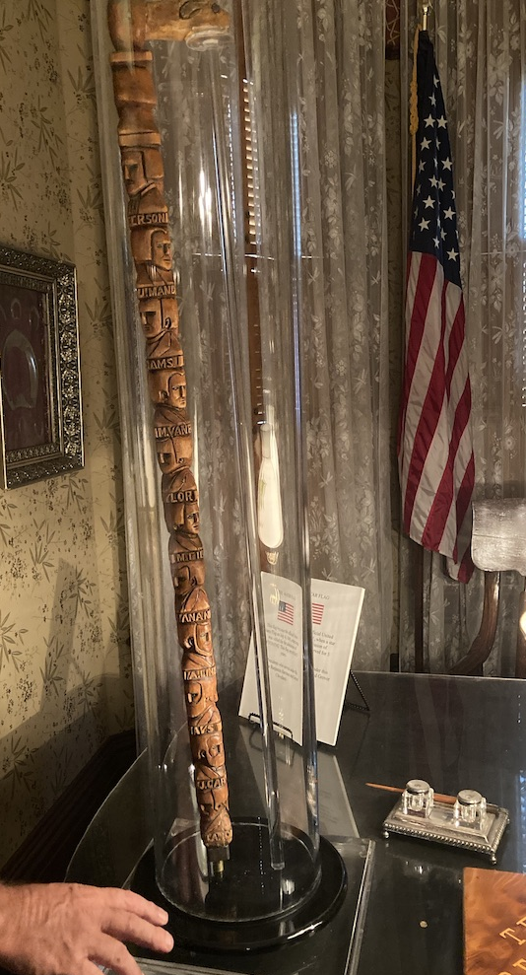
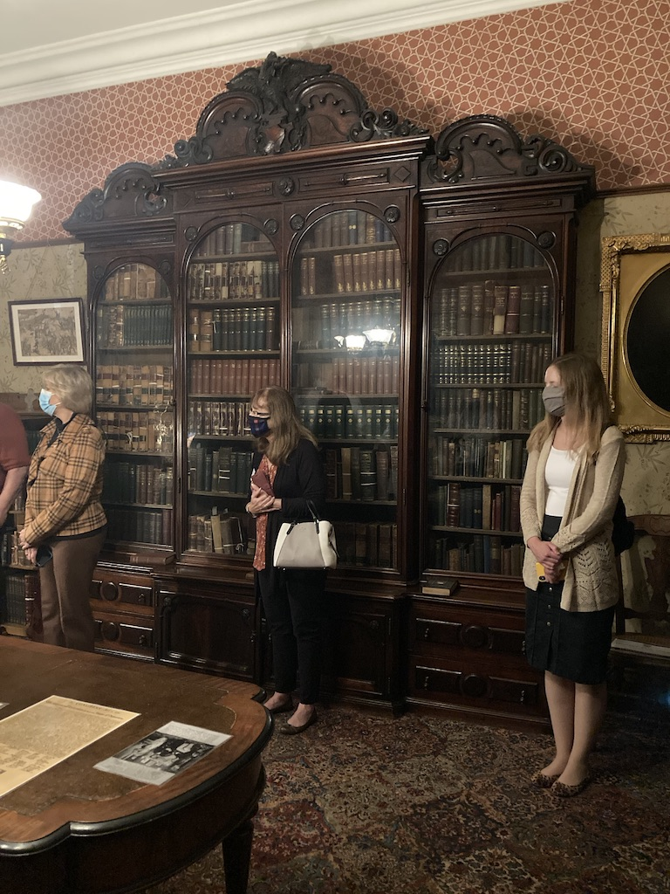

Slide 10
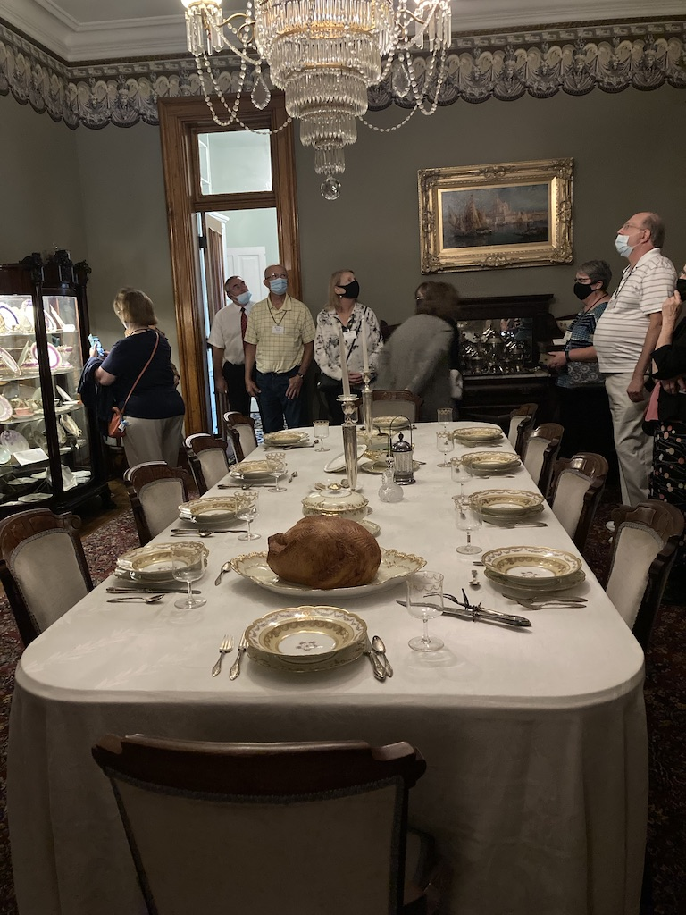
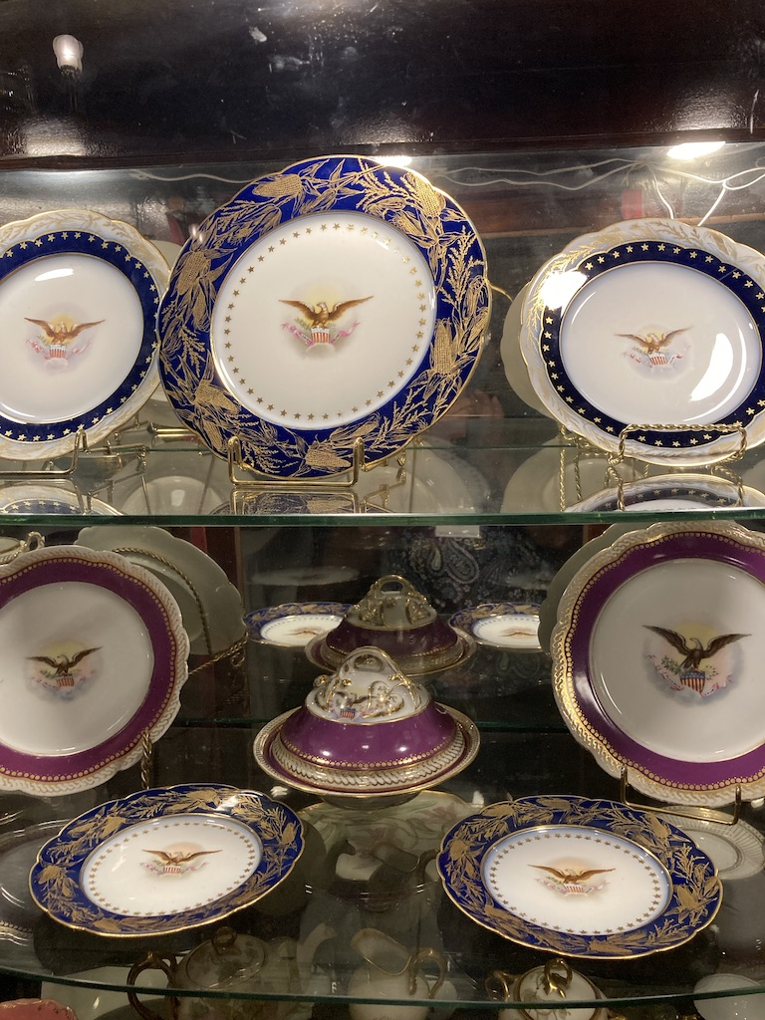

Slide 11
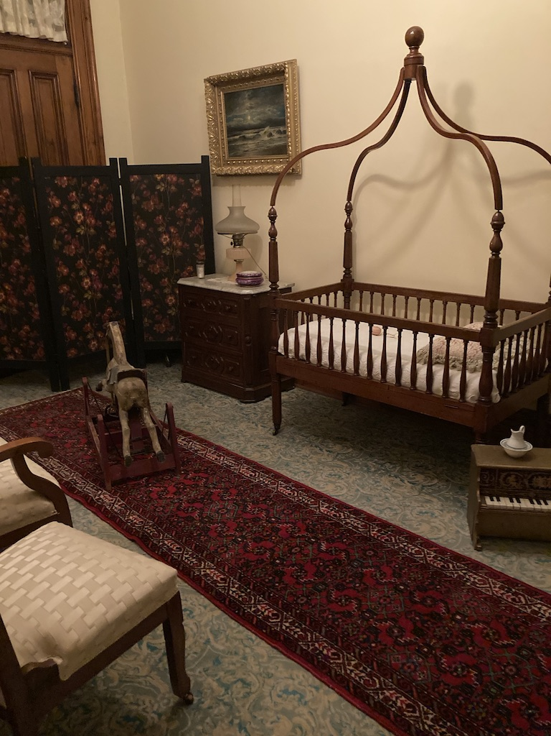
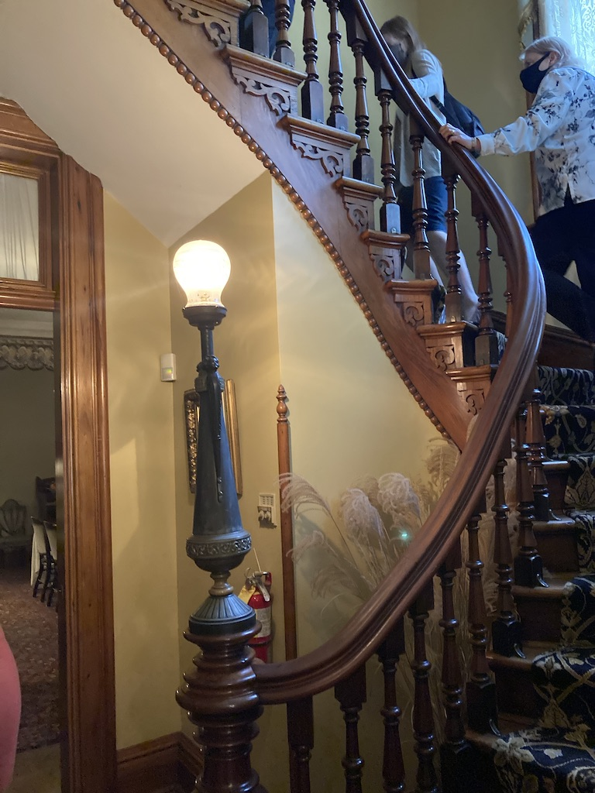
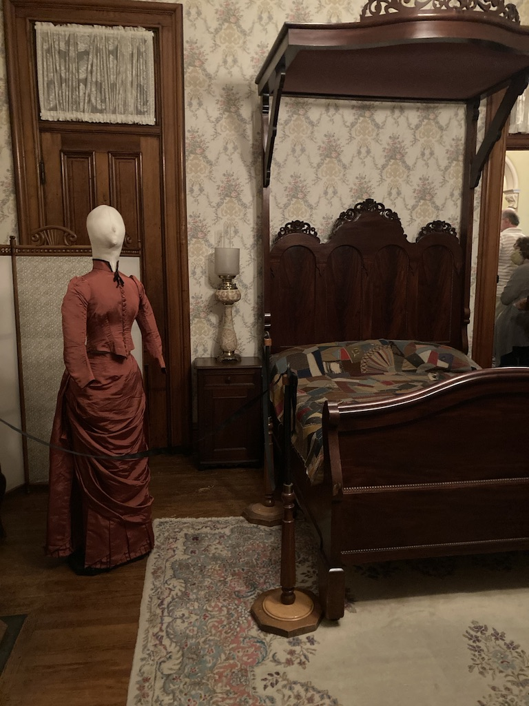

Slide 12
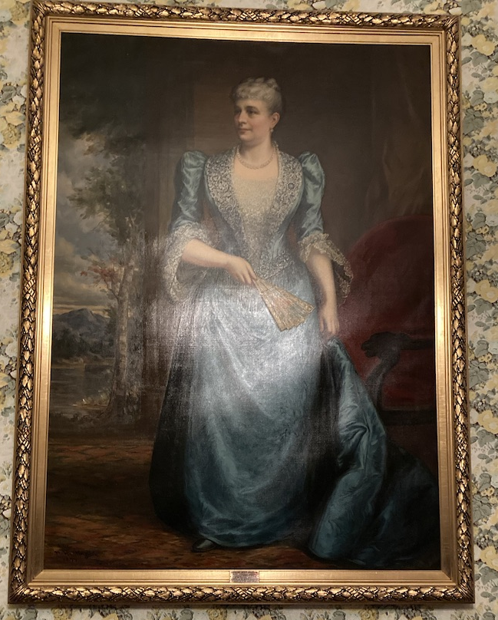
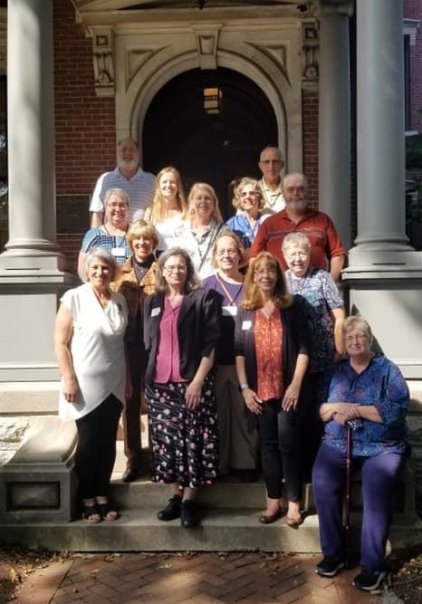
The Gang
1st Row
Jeri Klein, Edde Brunia (coordinator), Marla Suter (State Regent), Marsha Hucke
2nd Row
Tiffany Hauptman, Diane Murphy, Peggy Corrington
3rd Row
Connie Swartzendruber, Shannon Woods,Vicki Woods, Ruth Laachkman,Jim Corrington
4th Row
Robert Swartzendruber, and Darold Laackman
Caroline Scott Harrison
First DAR President General

Slide 13
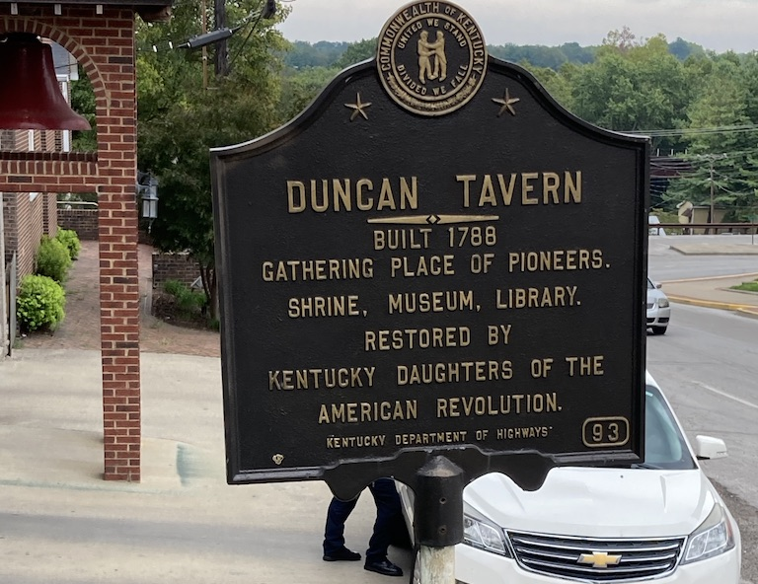
Duncan Tavern Historic Center Paris, KY
September 19,2021
Home of the Kentucky State
Daughters
and C.A.R.

Slide 14
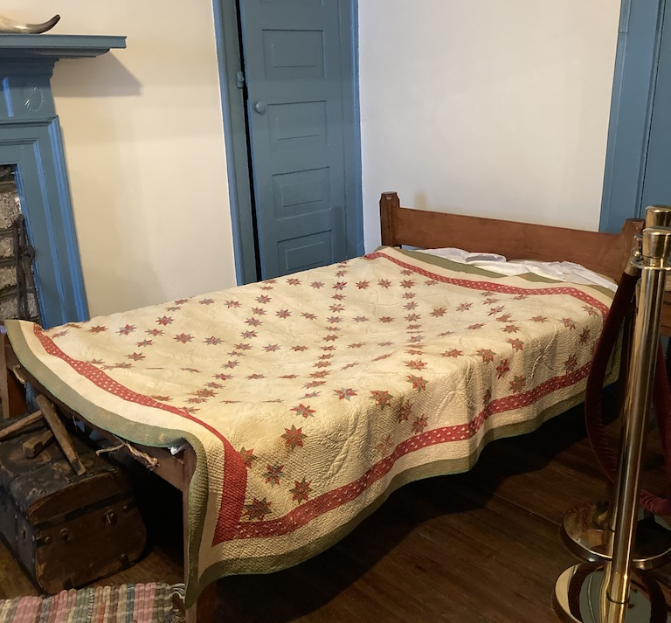
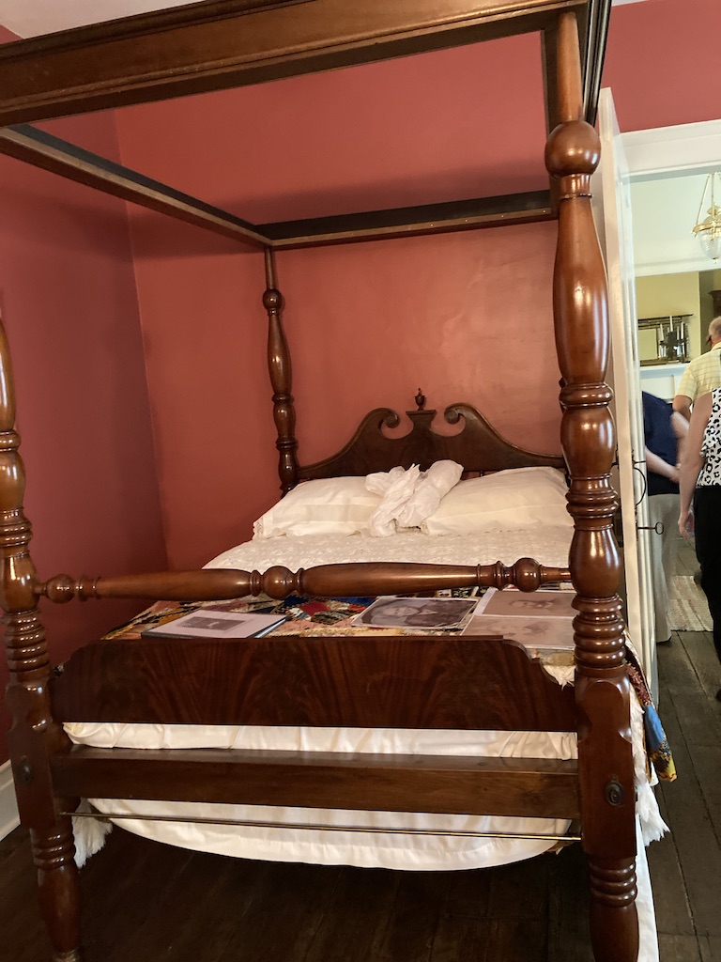
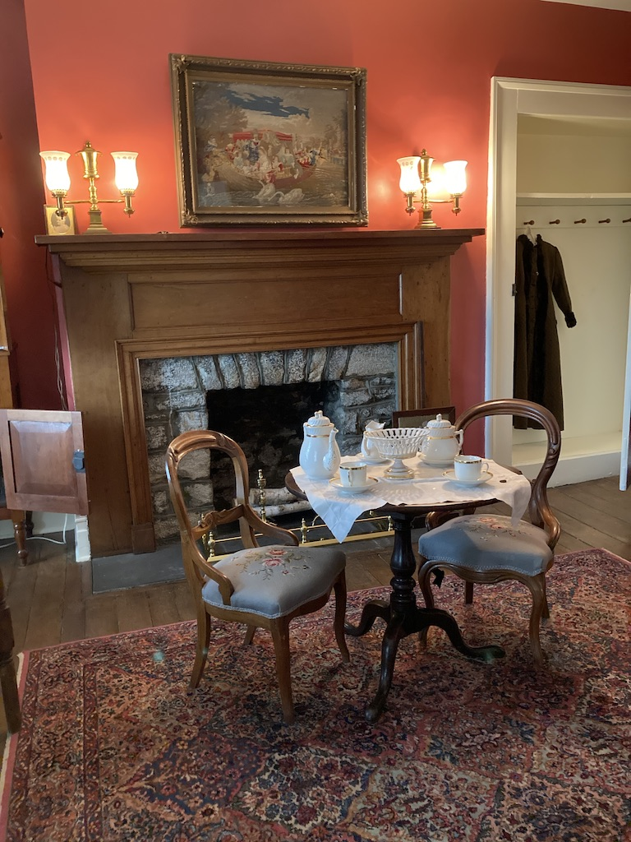
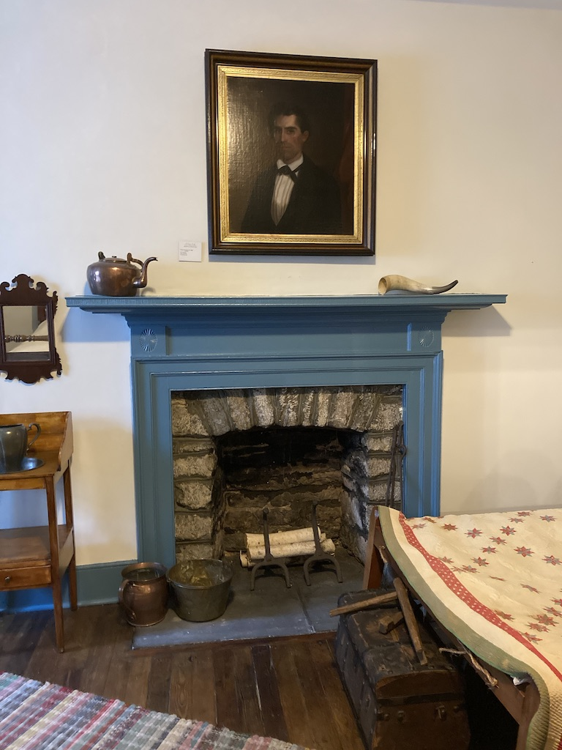
Bedrooms

Slide 15
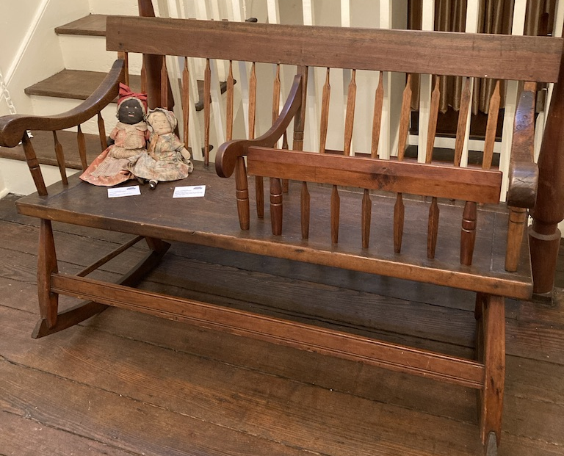
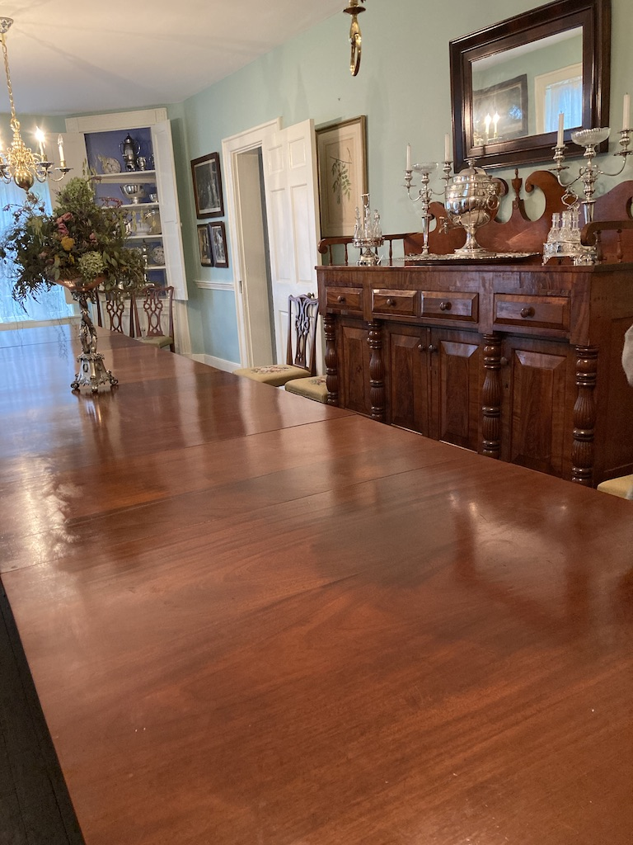
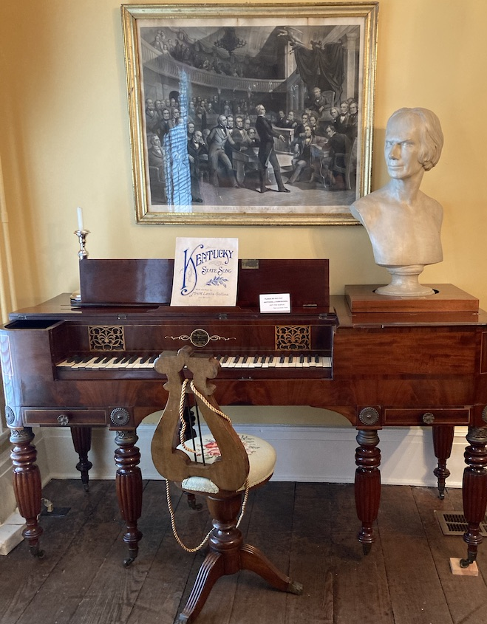
Furnishings
Piano
Bench for Mom & Baby
Dining Room Table
that seats 24

Slide 16
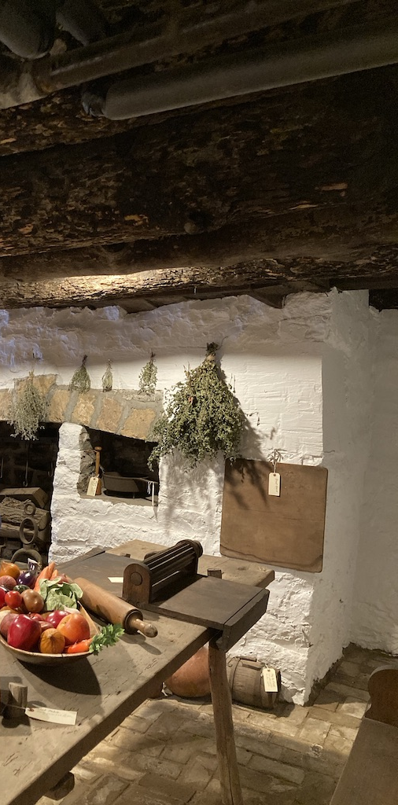
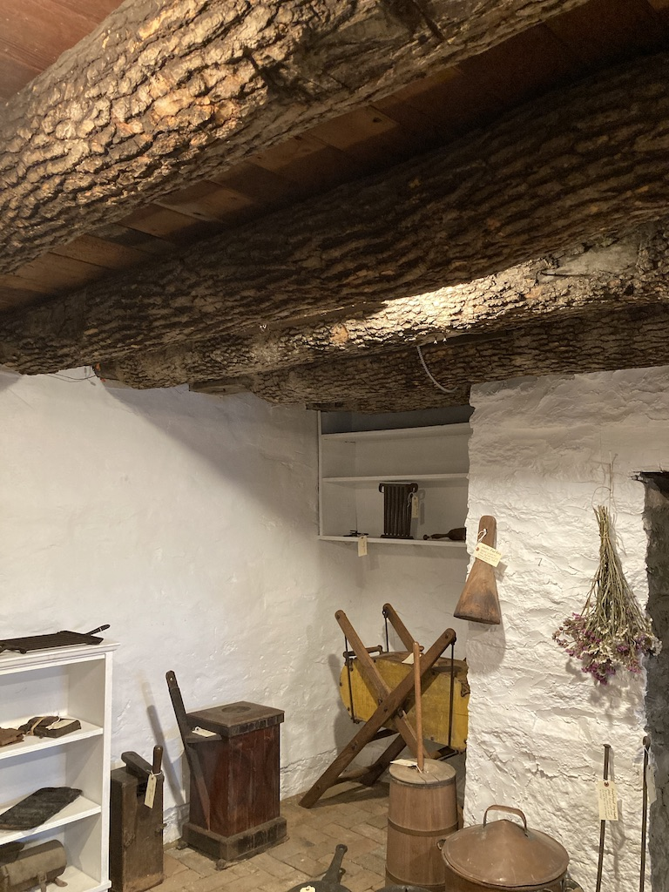
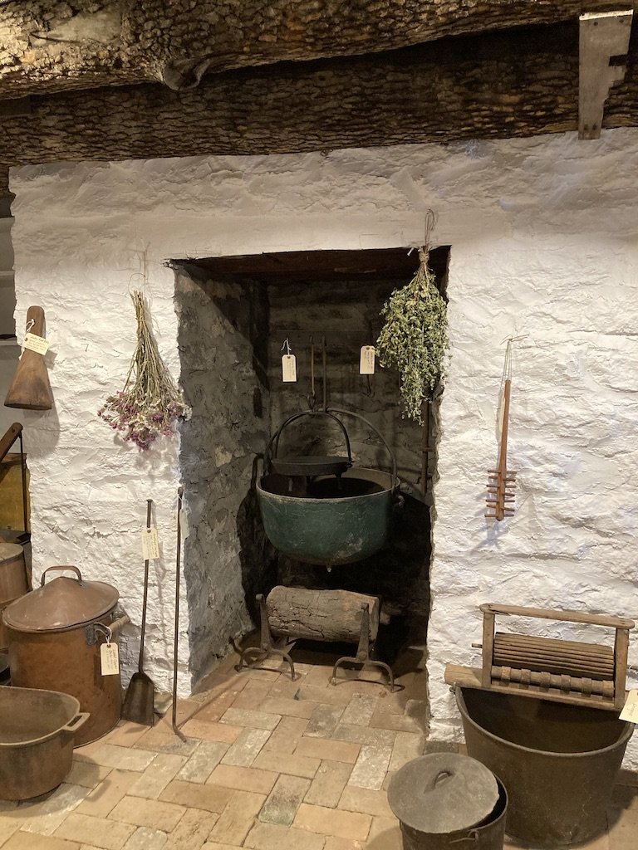
Kentucky CAR Society cleaned, restored and furnished the lower level
Note the logs used in the ceiling

Slide 17
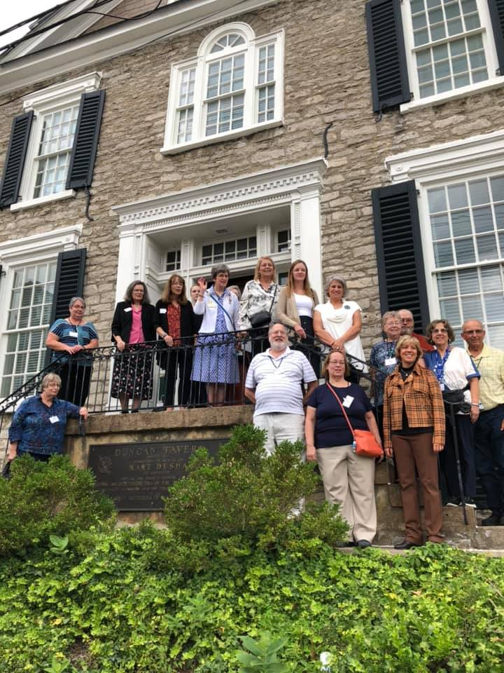

Slide 18
Hindman Settlement School. Hindman, KY
September 20,2021

Slide 19
Hindman Today
Dyslexia Intervention Services
Cultural Heritage Programs
Folk Arts Educationn Programs
Foodways Initiatives
Community Service Programs

Slide 20
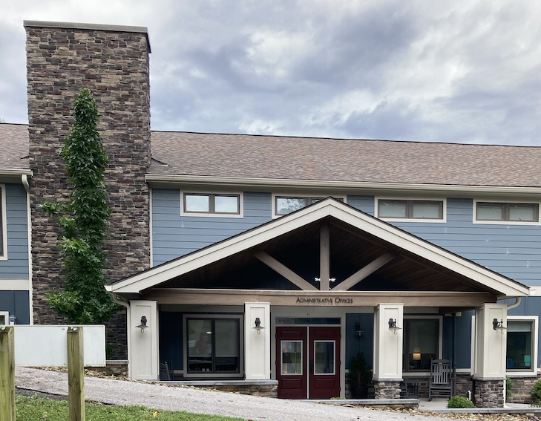
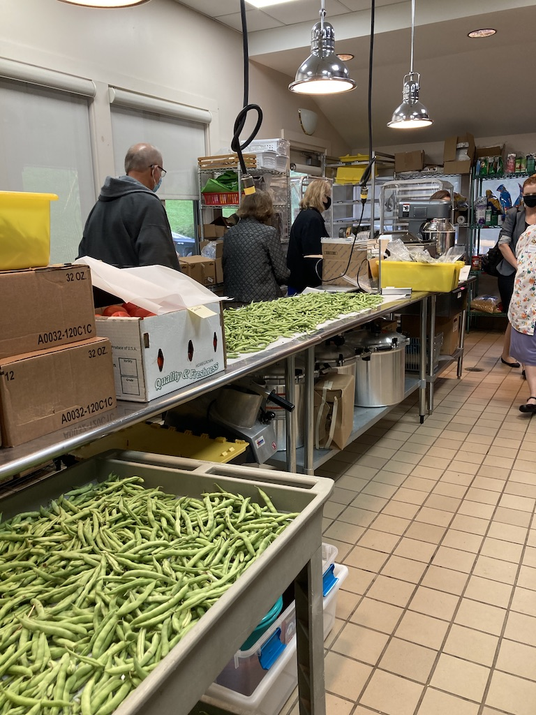
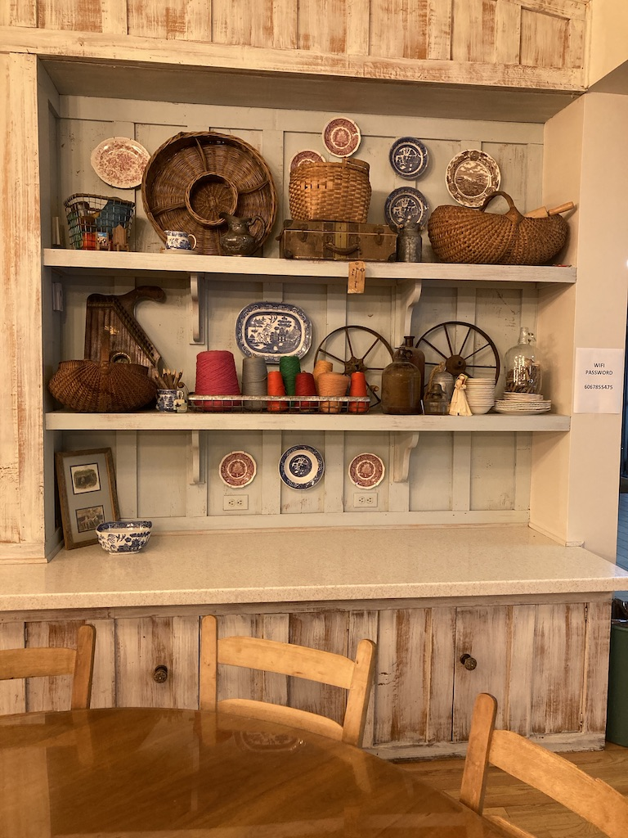

Slide 21
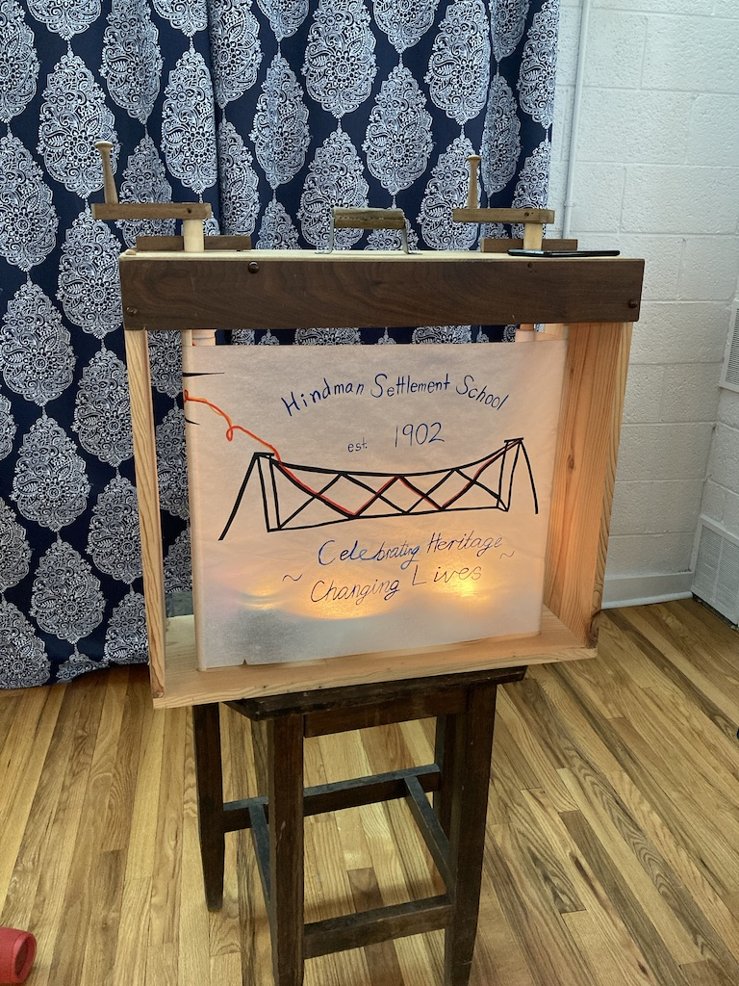
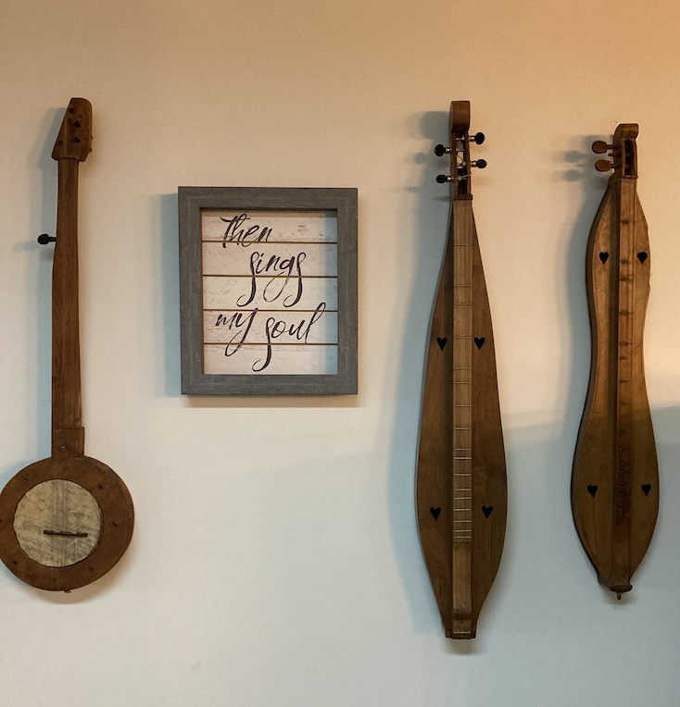
Presentation about Hindman School History and Dulcimer music

Slide 22
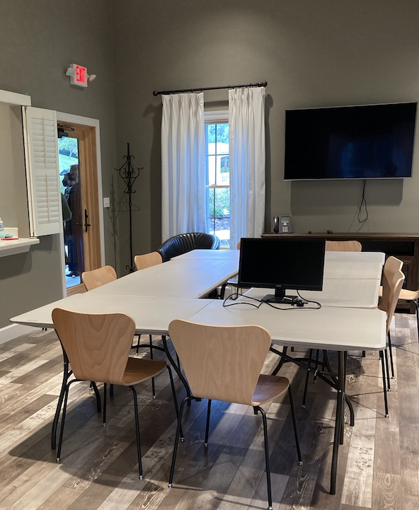
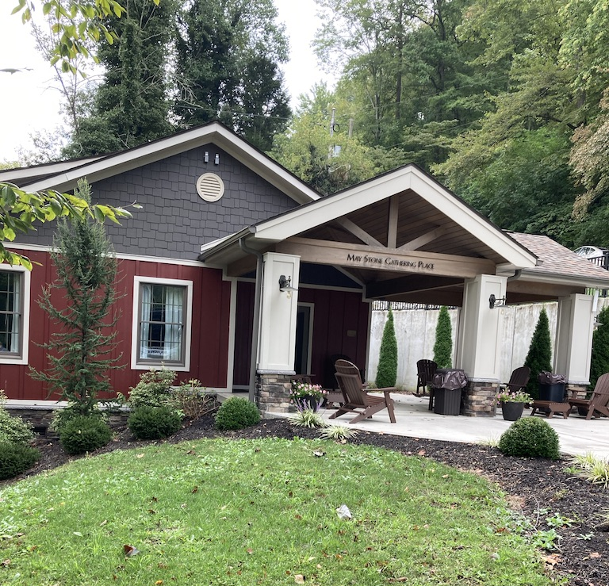

Slide 23
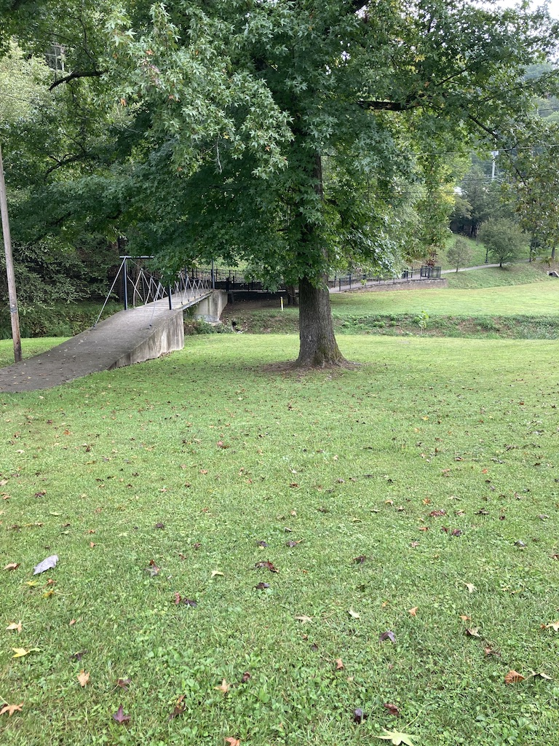
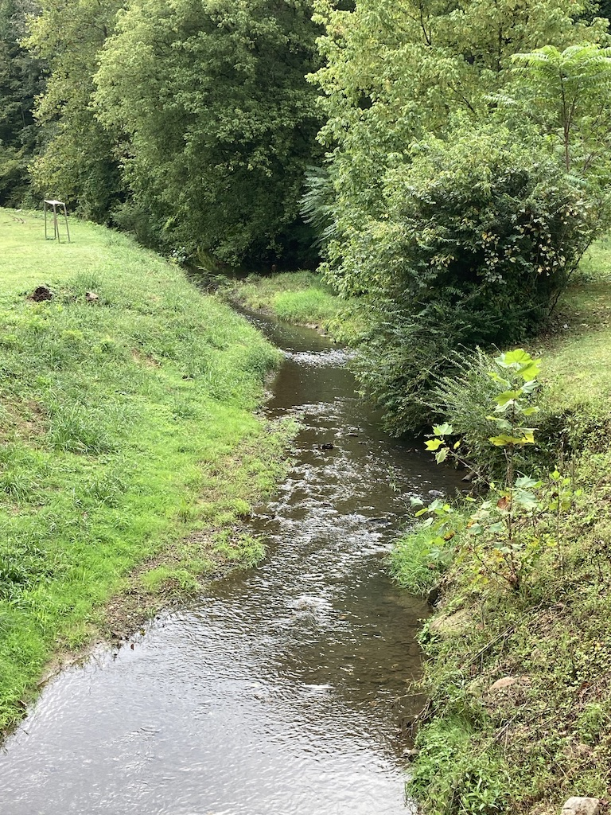

Slide 24
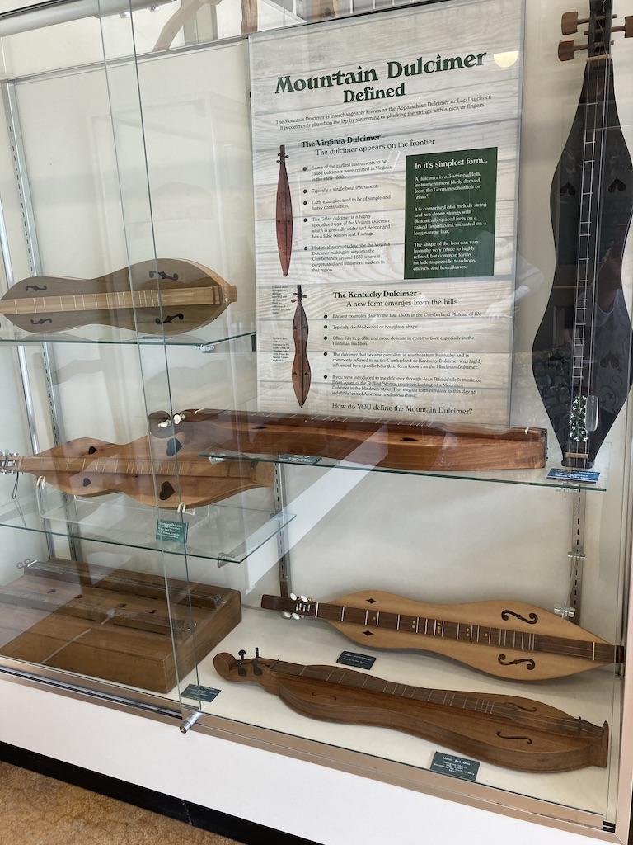
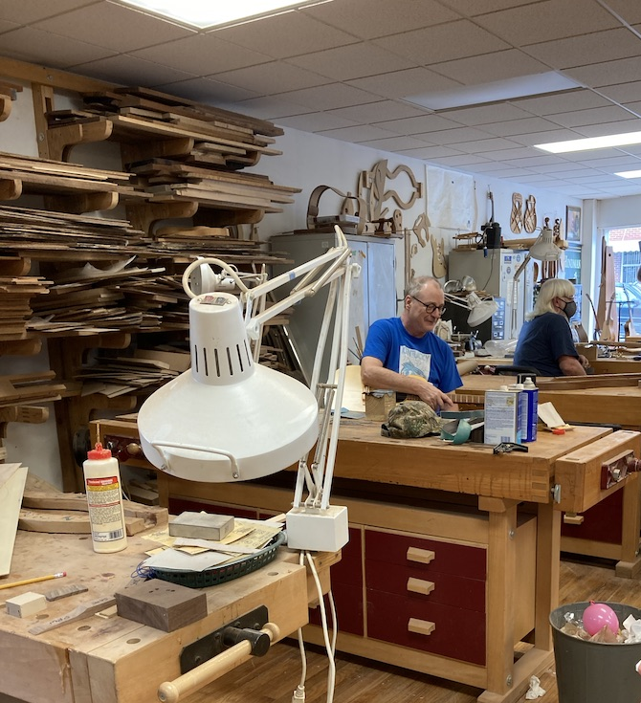

Slide 25
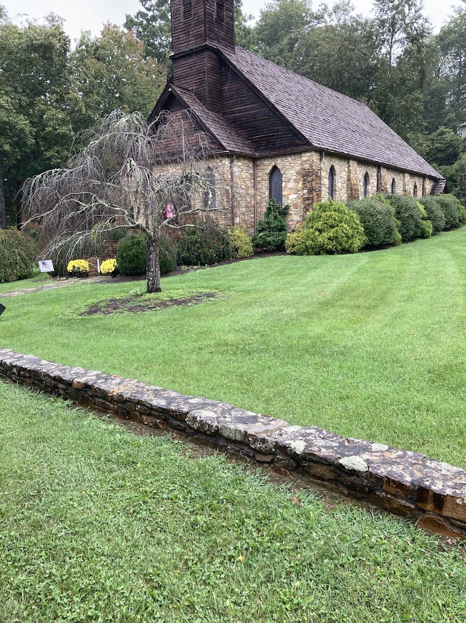
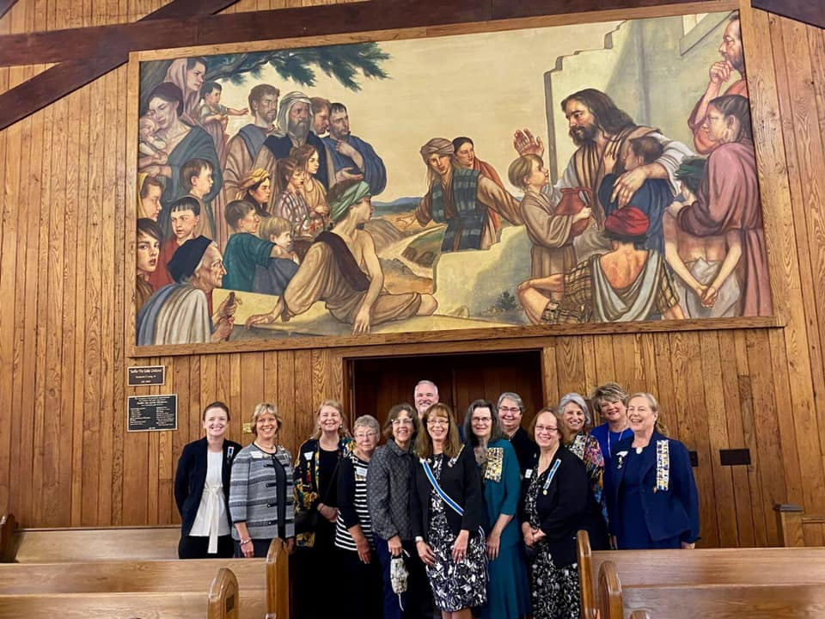
Crossnore School and Children’s Home
September 21,2021

Slide 26
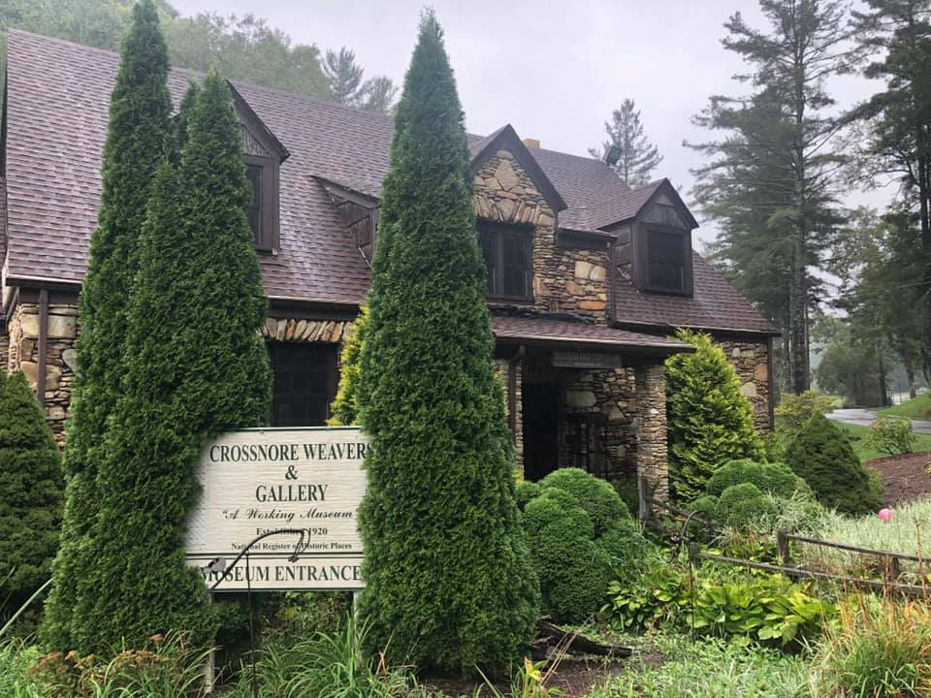
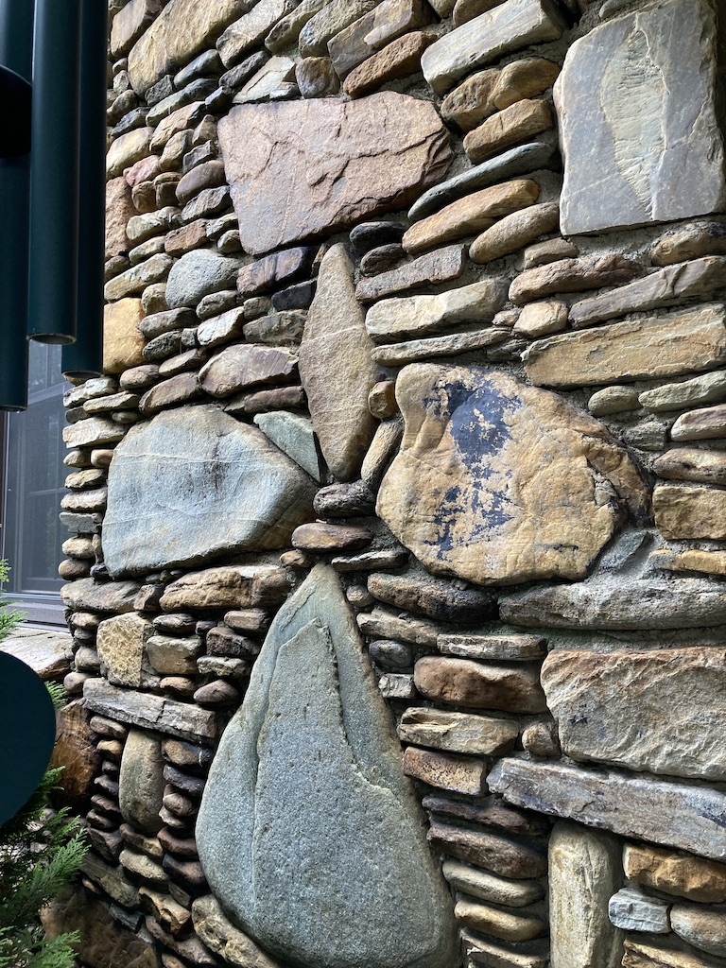
Crossnore Second Hand Store receives many DAR Clothing Donations. The School is noted for training skilled weavers to provide a means of employment for young women, Many of the older buildings are made of river rock carried by students to the building site.

Slide 27
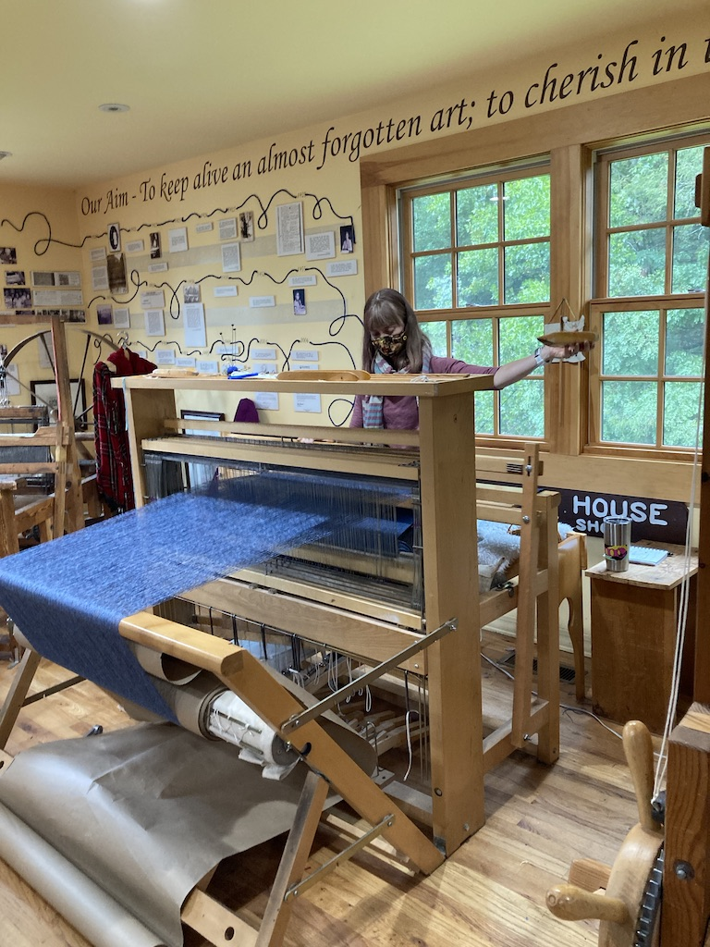
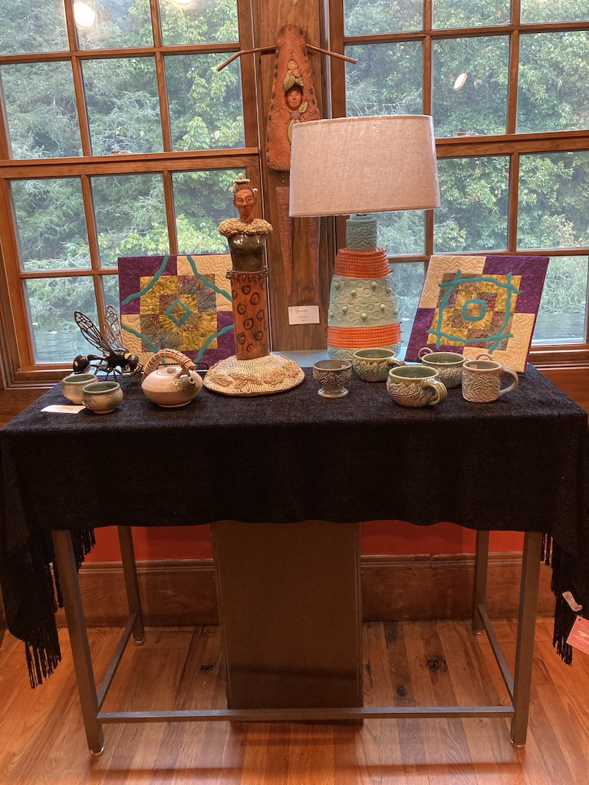
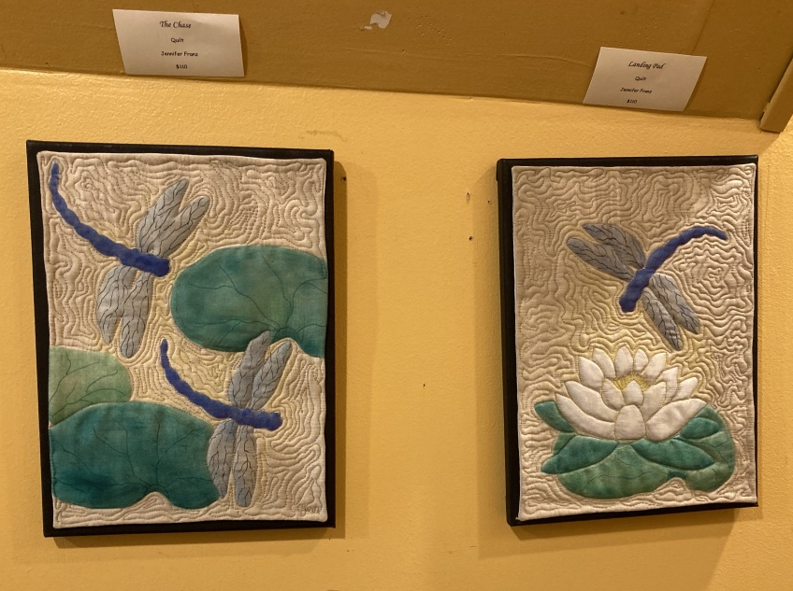
Inside the Gallery is a retail shop for woven goods and student art as well as the weaving room.

Slide 28
DAR approved in 1922 thanks to Dr. Mary Martin Sloop, Crossnore Boarding School founder, advocated for the school as young women students paged at
Continental Congress.

Slide 29
Biltmore Estate September 21,2021 Asheville, NC
This 8,000 Acre Estate is a National Historic Landmark and a family business.
The 250 Room French Renaissance Chateu. took 6 years to build from 1889-1905.

Slide 30
Billiard Room
Formal Dining

Slide 31
Atrium
Library

Slide 32
One of Many
Bedrooms
Music Room

Slide 33
Dressing
Roooms
Gym
Bowling
Alley
Pool

Slide 34
Kitchen

Slide 35
The Gardens

Slide 36
Botanical Gardens
Model Railroad Display

Slide 37
Botanical Gardens, Knoxville TN
September 22, 2021
Our only
Rainy Day

Slide 38
The Secret
Garden
Based on the novel by
Frances Hodgson Burnett
first published in 1911

Slide 39
National Medal of Honor Heritage Center Chattanooga, TN
September 22,2021
A brick was purchased to honor our
State Regent
Marla Suter

Slide 40
Museum Director performed
a battle of
Chattanooga reenactment
for our group.

Slide 41
Character Traits
of
Medal of Honor
Recipients

Slide 42
Displays

Slide 43
Berry College Mount Berry,GA September 23,2021
Worlds largest campus 27,000 Acres
2,100 Students
75 + majors and minors
99% of students are employed
NCAA Division III Sports
Ford Buildings ,a gift from Henry Ford in 1925
Martha Berry , a Georgia Daughter asked for support
of an education of the head, heart and hands
for mountain children in 1905

Slide 44
The Cage
Sports Complex
Alumni Hall
E.H. Young Theatre
Deer are on campus

Slide 45
Bell Recital Hall
Set up for lunch
with students
In Alumni Hall

Slide 46
WinShape Foundation
was founded in 1984
by Truett Cathy, Chick-fil-A. They partner with Berry College to provide educational opportunities for students.
Equine Facility

Slide 47
Oak Hill
Martha Berry’s Home

Slide 49
Kate Duncan Smith DAR School Grant, AL September 24,2021
Opened by Alabama DAR 1924
National support started in 1928
Public school
1,300 students
Half of students live in poverty
240 acres
40 buildings including 11 faculty residences
National Register of Historic Places

Slide 50
High School
Gym- Patriots
AG- Hydroponic lab
Art- Community Breast Cancer Fund raiser
Backpack volunteers
DAR was everywhere !

Slide 51
Students performed
a song for us and shared their art work. This is the auditorium
Iowa renovated in 2006

Slide 52
Student
Coloring
Page

Slide 53
Becker Hall Gym
Original Entrance and
the view from the steps

Slide 54
Grand Ole Opry Nashville, TN September 24,2021
The Show That Made
Country Music Famous

Slide 55
King Calaway
Jeannie Seely
Bill Anderson
Rhonda Vincent

Slide 56
National Quilt Museum Paducah, KY September 25,2021
Quilts made from 1980 –present
650 plus quilts in the Museum Collection
Exhibits change 8-10 times a year

Slide 57
Never Forget: Quilts from the 9/11 Memorial Museum Travelling Exhibit

Slide 58
A Betty Nielsen quilt,from Varina Iowa was part of the exhibit

Slide 59
Texture,
Texture,
Texture
Jim’s Favorite

Slide 62
Madonna of the Trail Monument Vandalia, IL
"Madonna of the Trail is a series of 12 monuments dedicated to the spirit of pioneer women in the United States. They were installed in each of the 12 states along the National Old Trails Road (Route 40), which extended from Bethesda, Maryland, to Upland, California.

Slide 63
Abraham Lincoln’s Tomb Springfield, IL September 25,2021
After Lincoln's death on April 15, 1865, his Illinois friends immediately sought permission to bury him in Springfield. The committee which arranged his Springfield funeral also formed an association to build this tomb, which was dedicated in 1874.

Slide 65
Lincoln the Soldier
Lincoln the Ranger
Lincoln the Lawyer
Standing Lincoln

Slide 67
Abraham Lincoln Presidential Library and Museum Springfield, IL September 25,2021
Interactive Displays
Artifacts
Videos

Slide 70
Crossing the Mississippi into Iowa THE END

